Slide 1
Illinois Data-Driven Health & Justice Webinar Series
Trauma-Informed Care and
Crisis Intervention Teams (CIT)
Wednesday, May 24, 2017
www.icjia.state.il.us/ddhj

Slide 2
Agenda
Learning Objectives
Presentation on Trauma-Informed Care
Local example: Lake County’s CIT program
Questions & Answers

Slide 3
Learning Objectives
Understand the impact of trauma on behavior and health outcomes
Recognize the effectiveness of trauma-informed care
Hear how law enforcement can apply Crisis Intervention Team training and trauma-informed care to deal with superutilizers

Slide 4
Trauma-Informed Care
Alicia Boccellari, Ph.D.
Alicia Boccellari, Ph.D. is a Clinical Professor of Clinical Psychiatry and the Chief Psychologist in the UCSF Department of Psychiatry, Zuckerberg San Francisco General Hospital (ZSFG). She is also the Director of the Trauma Recovery Center (TRC). The TRC is designed to provide comprehensive mental health, case management and psychosocial services to survivors of violent crime. In addition, Dr. Boccellari has been working with the California State Legislature to replicate the TRC evidence-based model of care in 10 other cities in California. The UCSF TRC model is also currently being replicated in Ohio.

Slide 5
Impact of Trauma on Health Outcomes and High Risk Behaviors and the UCSF Trauma Recovery Center Model
Alicia Boccellari, Ph.D.
May 24, 2017

Slide 6
Acknowledgements
Slides adapted from:
San Francisco Department of Public Health Trauma Informed System of Care
Robert Anda, MD and Vincent Felleti, MD
Kaiser Permanente and the Centers for Disease Control

Slide 7
WHAT IS TRAUMA?
“Trauma is not an event in itself but, rather, a response to an experience that is so stressful that it overwhelms an individual’s capacity to cope”.
Susan Craig (2008) Reaching and Teaching Children Who Hurt

Slide 8
Trauma = Event, Experience, & Effect
Event
Actual or extreme threat of harm
Experience
Terror
horror
pain

Fight / Flight - Freeze

Helpless
to escape
Overwhelms brain and body
Effect
Dis-integration
Dysregulation
(Herman, 1997; Van der Kolk, 2005; DSM-IV-TR; SAMHSA; Siegel, 2012; Bloom, 2013)
Lasting adverse effects
SFDPH Trauma 101 Slide

Slide 9
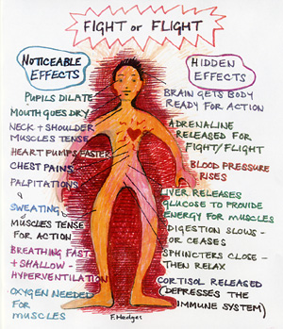
Fight, flight, freeze

Slide 10
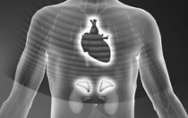
Chronic Stress Causes “Wear and Tear” on the Body
Medical illnesses
  Immune system suppression
  Inflammatory diseases
  Obesity
Adverse effects on brain and cognitive functioning
From stressors that are chronic, uncontrollable, experienced without support from caring others
Can result from stressors like bigotry, poverty, chronic hunger
(Bloom, 2013; McEwen, 2000)
SFDPH Trauma 101 Slide

Slide 11
Stress and Trauma Are Public Health Issues
Stress linked to 6 leading causes of death
Heart disease, cancer, lung ailments, accidents, cirrhosis of the liver, and suicide
Trauma impacts more than just the individual
Ripple effect to others
Some communities disproportionately affected:
Bigotry + Urban Poverty + Trauma = Toxic
Intergenerational transmission of trauma
Systemic, preventative approach needed
SFDPH Trauma 101 Slide

Slide 12
Let's talk about Adverse Childhood Experiences: ACEs
Felitti, Anda, et al. 1998

Slide 13
The Adverse Childhood Experiences (ACE) Study
Examines the health and social effects of ACEs
throughout the lifespan among 17,421 members
of the Kaiser Health Plan in San Diego County
What do we mean by Adverse Childhood Experiences?
-childhood abuse and neglect
-growing up with domestic violence, substance abuse or mental illness in the home, parental discord, crime
Felitti, Anda, et al. 1998

Slide 14
Adverse Childhood Experiences Are Common
Household dysfunction:
Substance abuse | 27%
Parental sep/divorce | 23%
Mental illness | 17%
Battered mother | 13%
Imprisoned household member | 6%
Abuse:
Psychological | 11%
Physical | 28%
Sexual | 21%
Neglect:
Emotional | 15%
Physical | 10%

Slide 15

Adverse Childhood Experiences Score
Number of categories (not events) is summed…
ACE Score Prevalence
0 33%
1 25%
2 15%
3 10%
4 6%
5 or more 11%*
Two out of three experienced at least one category of ACE.
If any one ACE is present, there is an 87% chance at least one other category of ACE is present, and 50% chance of 3 or >.
* Women are 50% more likely than men to have a Score >5.

Slide 16
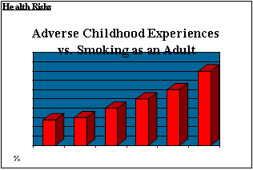

Slide 17
Health Risks
Childhood Experiences vs.
Adult Alcoholism
4+
3
2
1 1
0

Slide 18
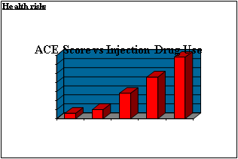

Slide 19
Emotional costs
Childhood Experiences
Underlie Suicide Attempts
4+
3
2
0
1

Slide 20
With an ACE Score of 0, the majority of adults have few,
if any, risk factors for these diseases.

Slide 21
However, with an ACE Score of 4 or more, the majority of adults have multiple risk factors for these diseases or the diseases themselves.

Slide 22
Adverse Childhood Experiences Rarely
Occur in Isolation…
They come in groups.

Slide 23
How does trauma affect the individual?
Trauma shapes the survivor’s basic beliefs about themselves, others, their world view, spirituality.
  Who am I?
  The world is no longer safe
  Others can’t be trusted
  I have to protect myself no matter what
  I can’t believe in anything now.
Notes:
23
CAROL
Theoretical Framework – means approaching trauma survivors with understanding of how trauma impacts their reactions and recognizing:
1. Symptoms are adaptations.
Understanding reactions in the context of trauma person experienced. People do what they do to survive. Differ here from traditional psychoanalytic views, which have often viewed many of the symptoms as inherent. Eg. DV survivor “I stayed with this guy because I thought he would kill me” or drinking to manage trauma related feelings
2. Trauma shapes the survivor’s basic beliefs about identity, world view, and spirituality. (no matter if it was a one time event or chronic, people ask why did this happen to me?)
SO ….
THE QUESTION TO ASK WHEN COMING FROM A TRAUMA INFORMED PERSPECTIVE IS THEN NOT “WHAT IS WRONG WITH YOU?” BUT “WHERE DOES THIS BEHAVIOR COME FROM?”

Slide 24
Basic capacities damaged by trauma: continued
Trust:
  Inability to trust
  Too trusting (can contribute to re-victimization)

Slide 25
Basic capacities damaged by trauma, continued:
Emotional extremes, difficulty modulating:
  Intense affect
  Hyper arousal, nightmares, flashbacks
  Dissociation, self harm

Slide 26
Basic capacities damaged by trauma, continued:
Disrupted relationships, Boundary issues:
  Hard to assess safe relationships
  Reenact role (victim, perpetrator, bystander)
  Difficulty w/ vulnerability & intimacy

Slide 27
How does trauma impact behavior
•Inappropriate behaviors •Failures to connect cause and effect
•Failure to understand directions •Perfectionism
•“Overreacting” to comments or •Depression
facial expressions •Anxiety
•Hypervigilence •Self-destructive behaviors
•Aggression •Fear and vulnerability
•Feelings of worthlessness

Slide 28
Prevalence: Trauma History
Rates are higher in the population with severe mental illness (SMI) – 98% of SMI clients report at least one type of qualifying event in their lives. 51-97% of female SMI clients reporting sexual and or physical assault during their lifetime (Goodman, Rosenberg, Mueser, & Drake, 1997).
Recent exposure: in a multi-site sample, approximately 1/3rd of SMI clients reported physical or sexual assault in the past year (Goodman, et al).
Notes:
28
MELISSA:
Rates are higher in the population with severe mental illness (SMI)– 98% of SMI clients report at least one type of qualifying event in their lives. 51-97% of female SMI clients reporting sexual and or physical assault during their lifetime (Goodman, Rosenberg, Mueser, & Drake, 1997).
Recent exposure: in a multi-site sample, approximately 1/3rd of SMI clients reported physical or sexual assault in the past year (Goodman, et al).
What do you guys think prevalence looks like with the clients you work with?

Slide 29
PTSD Risk in Underserved Populations
Patients served in public sector health care settings share additional risk factors:
  Lack of social support
  Adverse childhood experiences
  Low SES
  Limited education
  History of psychiatric disorder
  Kessler et al. (1995); Cottler et al (1992).
Notes:
29
MELISSA: Public sector patients also often face additional life stressors that can increase their risk of developing PTSD.
These risk factors can include:
Possible lack of social support – both perceived and real
Adverse childhood experiences, including childhood abuse and neglect
Low Socioeconomic status
Limited education
And a history of other psychiatric disorders

Slide 30
Prevalence of the dual diagnosis of PTSD and Substance Abuse
• Co-occurring diagnosis of PTSD and Substance Abuse in addiction treatment facilities - 12% - 34%
• Women in substance treatment – 30% - 59%
• Men in substance treatment – 11% - 38%
Typically PTSD symptoms preceded the onset of substance abuse.
Najavits, L. M., (2002) Seeking Safety A Treatment Manual for PTSD and Substance Abuse.
New York: Guilford

Slide 31
Links Between PTSD and Substance Abuse
•Two main themes of both disorders are secrecy and control
•Each of the disorders makes the other more likely
•PTSD symptoms widely reported to become worse with initial abstinence
•Both situations produce a profound need to be in an altered state
Najavits, L. M., (2002) Seeking Safety A Treatment Manual for PTSD and Substance Abuse.
New York: Guilford

Slide 32
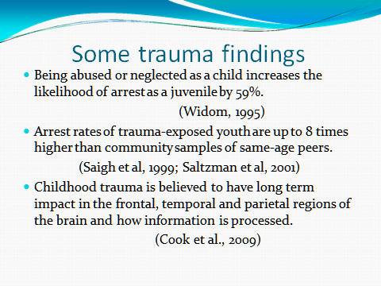

Slide 33
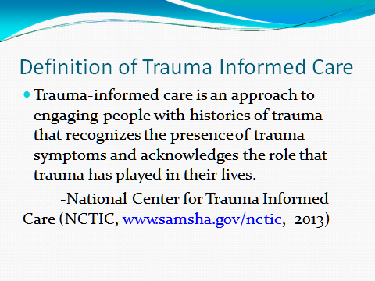

Slide 34
Trauma-Informed Approach
Recognizes the widespread impact of trauma and understands potential paths for recovery;
Recognizes the signs and symptoms of trauma in clients, families, staff, and others involved with the system;
Responds by fully integrating knowledge about trauma into policies, procedures, and practices; and
Seeks to actively resist re-traumatization.
SAMSHA

Slide 35
Context
•Trauma provides the context for behaviors
•Move from:
• What is wrong with you?
• What has happened to you?
SFDPH Trauma 101 Slide

Slide 36
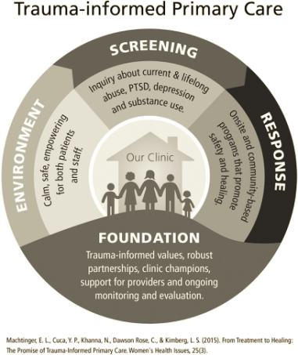

Slide 37
SAMHSA’s Six Key Principles of a Trauma-Informed Approach
Safety
Trustworthiness and Transparency
Peer support
Collaboration and mutuality
Empowerment, voice and choice
Cultural, Historical, and Gender Issues

Slide 38
Traditional Psychotherapy for Trauma Victims
Office-based, no home visits
No practical assistance or coordination with other service systems
50-minute hour
Feeling, insight, and disclosure-oriented

Slide 39
Vision: A New Model of Care
Emphasis upon assertive tracking, outreach, and engagement into services; AND
Clinical case management to address all basic needs (medical, legal, financial, housing, services etc.); AND
Evidence-based psychotherapy to target psychiatric distress and increase interpersonal safety

Slide 40
Engagement, Tracking & Outreach
Many victims feel ashamed about entering therapy and/or avoid trauma reminders.
We work with them on what is most important to them first until rapport is built.
We will see them at the hospital, at their home, or in their community (including homeless encampments, shelters, etc.).

Slide 41
Summary Results
77% of survivors receiving TRC services engaged in mental health services when compared to 34% in customary care
Increased the rate by which sexual assault survivors received mental health services from 6% to 71%
88% of clients reported an improvement in day-to-day functioning
87% of clients reported an improvement in coping with alcohol and drug problems

Slide 42
Summary Results, continued:
PTSD symptoms decreased by 38% over 16 TRC sessions
Depression decreased by 52% over 16 TRC sessions
The TRC model costs 34% less than customary care

Slide 43
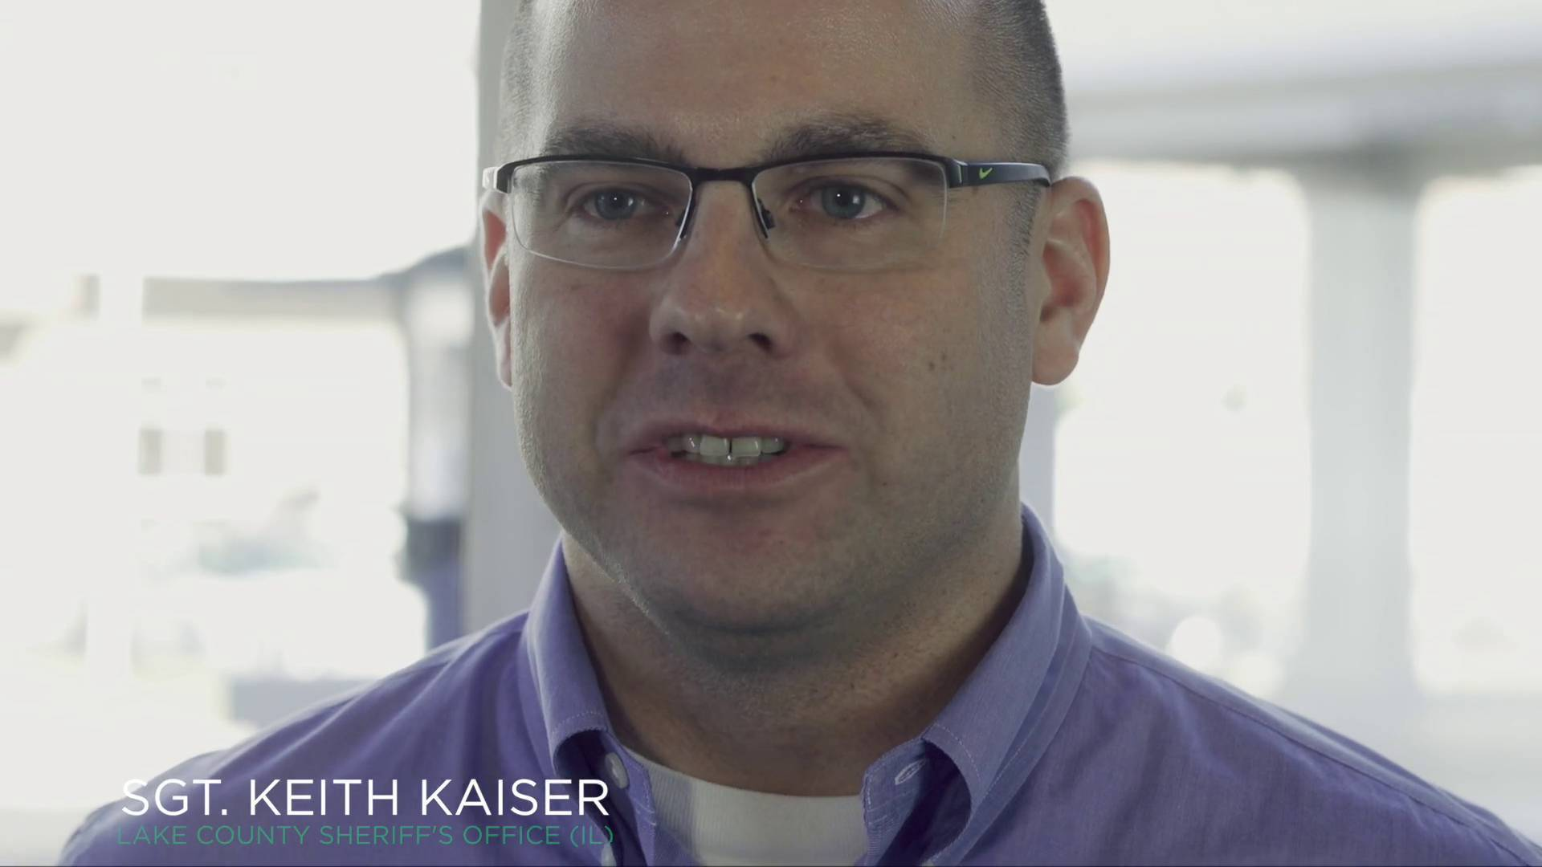
Lake County CIT
Sgt. Keith Kaiser
Keith Kaiser is a Sergeant with the Lake County Illinois Sheriff’s Office. He has been a police officer for 16 years and has served in numerous positions throughout the Sheriff’s Office. Keith obtained a Master of Science degree from Lewis University in Public Safety Administration. Last November, Keith was appointed to the Sheriff’s position of Director of Training and Crisis Intervention Team Coordinator.

Slide 44


Lake county sheriff’s office
Crisis intervention team program
Keith Kaiser

Slide 45
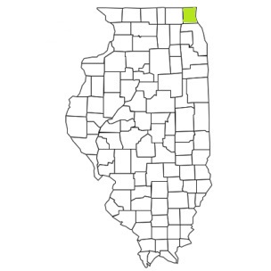
Lake County, Illinois Demographics
    Northeast Corner of Illinois
    Illinois 3rd largest county
      Population ~ 700,000
      Sheriff’s Office serves ~ 130,000
      445 square miles
    Diverse Communities
      Wealthy communities – Median Household Income ~ $150,000
      Underprivileged communities – Median Household Income ~ $38,000
    Veteran Population ~ 34,000
    Homeless Population ~ 300 (Point in Time Count)
    County Poverty Rate ~ 9%
    Sheriff’s Office ~ 580 Employees
        ~ 200 Law Enforcement
        ~ 200 Corrections Officers
    1,350 Law Enforcement Officers in Lake County

Slide 46
Lake County Sheriff’s Office
CRISIS INTERVENTOIN TEAM PROGRAM
CRISIS INTERVENTION
&
CRISIS INTERVENTION TEAM TRAINING

Slide 47
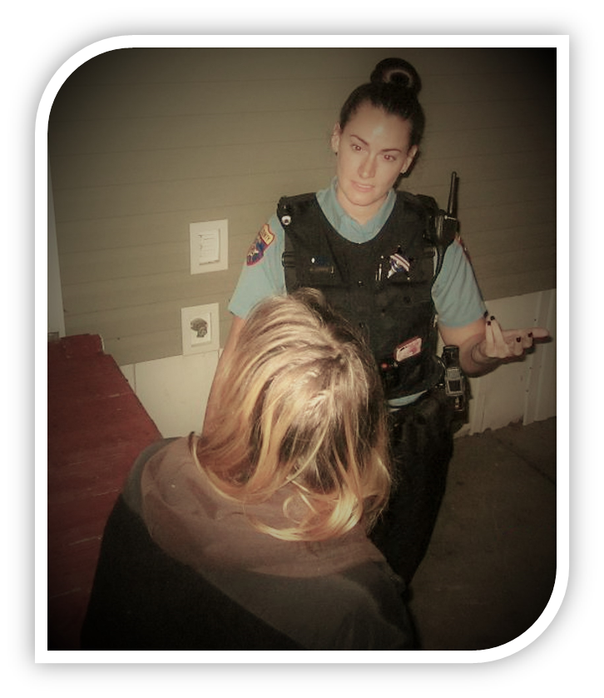
OUR PROBLEMS:
National studies estimate 10% of law enforcement activities encounter persons with mental disorders.
Lake County Sheriff’s Office ~20,000 encounters / year with persons with mental disorders.
Incarceration:
15% have a serious mental disability (National Average)
41% recidivism rate within a 3 years period (Lake County Jail)
CIT Program:
2005 – 16 Deputies - 4 Corrections Officers Trained
2014 – 4 Deputies - 1 Corrections Officer Trained
The program was not utilized or implemented properly…
“You don’t know what you don’t know.”

Slide 48
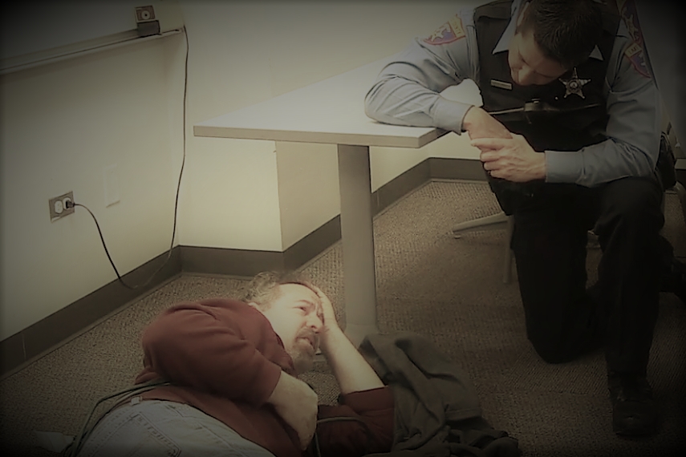
WHAT HAVE WE DONE?
County Board appropriated $30,0000 for CIT Training
  Include municipal police in trainings
Implemented policies and procedures for CIT situations
A variety of employees are now CIT trained ~100
Established partnerships with local organizations
Educated the community in regards to Crisis Intervention
JMHCP - $250,000 CIT Grant
  Train 395 officers throughout the county
  Track, evaluate, and follow-up with recipients of interventions
  Familiarize officers with behavioral health resources and behavioral health providers
Notes:
We went to the county board and identified the problem to them

Slide 49
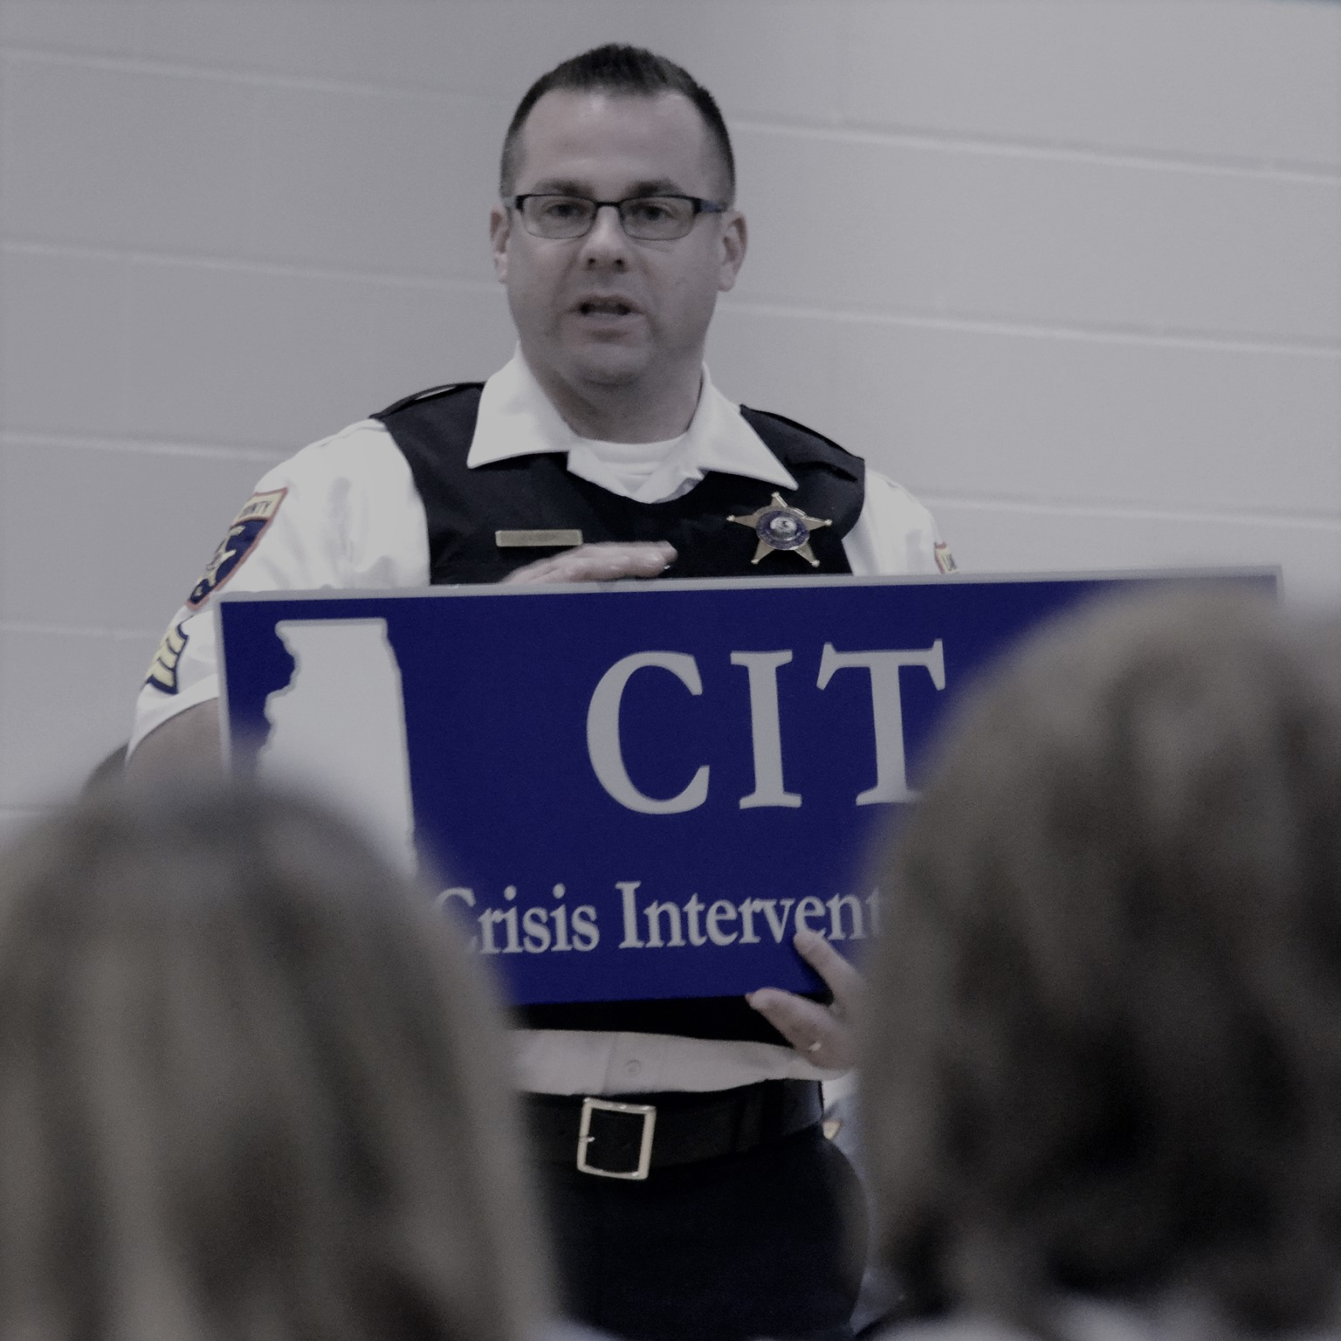
WHERE DO WE WANT TO BE…
Reduce the incarceration of mentally ill and provide them with positive interventions and connections
  Track the identified Super Utilizers
Establish a local ILETSB certified CIT Training Host
Consistent CIT policies and procedures - county-wide
Integrate mental health providers and community members into the Crisis Intervention Team
Open two-way communication with providers
Develop a Mobile Response Team and Drop-In Centers
Establish community follow-up services:
  Rides to treatment
  Checks on truancy from appointments
Tracking and data evaluation - county-wide
Notes:
We went to the county board and identified the problem to them

Slide 50
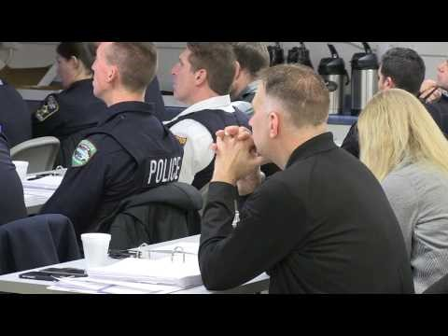
Notes:
https://www.youtube.com/watch?v=2GgoGqExZYU&t=2s

Slide 51
Lake County sheriff’s office crisis intervention team program
Keith Kaiser
Strategic Services Unit – Training Section
Lake County Sheriff’s Office
25 S. Martin Luther King Jr. Ave.
Waukegan, IL 60085
847.377.4262 | Fax: 847.984.5736
kkaiser@lakecountyil.gov

Slide 52
Questions?

Slide 53

Contact
Alicia Boccellari, Ph.D.
Chief Psychologist
Director of Special Programs
USCF Trauma Recovery Center
USCF Department of Psychiatry
Alicia.Boccellari@sfdph.org
Sergeant Keith Kaiser
Director of Training
Crisis Intervention Team Coordinator
Strategic Services Unit - Training Section
Lake County Sheriff’s Office
Kkaiser@lakecountyil.gov

Slide 54
Visit the DDHJ website
www.icjia.state.il.us/ddhj

